Slide 1


Technology as a Solution
[PRESENTER NAME HERE]

Slide 2

Why Societal Challenges Matter
ACCESS
TRANSFORMATION
UNDERSERVED
Societal challenges significantly impact access to opportunity, limiting individual potential and contributing to persistent inequalities within communities.
Technology serves as a powerful tool for transformation, driving innovation and enabling solutions that can address complex societal issues effectively.
The right technology has the potential to reach the most underserved, ensuring that marginalized communities benefit from advancements and improve their quality of life.

Slide 3




Key Societal Challenges Impacting Communities Today
EXCLUSION
EMPLOYMENT
HEALTHCARE
Many people lack access to financial services.
Job seekers often have skills that don't match.
Many communities struggle to access quality healthcare services.

Slide 4

The Digital Divide: Access Disparities
UNEQUAL TECHNOLOGY ACCESS
Rural communities face significant barriers to technology, including higher costs, limited availability, and low digital literacy rates, impacting their opportunities.

Slide 5
Technology as an Enabler
EFFICIENT SCALING
Technology allows for rapid scaling of solutions, meaning that services can expand to meet growing demands without significant delays or costs.
COST REDUCTION
By leveraging technology, organizations can reduce service delivery costs, making essential services more affordable and accessible to underserved populations.
CONNECTIVITY OPPORTUNITIES
Technology connects individuals to new opportunities, facilitating access to resources, information, and networks that can enhance their quality of life.

Slide 6

Case Study: M-Pesa and Its Impact
INNOVATION THROUGH SIMPLICITY
M-Pesa utilizes USSD & SMS technology, enabling financial transactions on basic phones and driving financial inclusion across rural Kenya effectively.

Slide 7
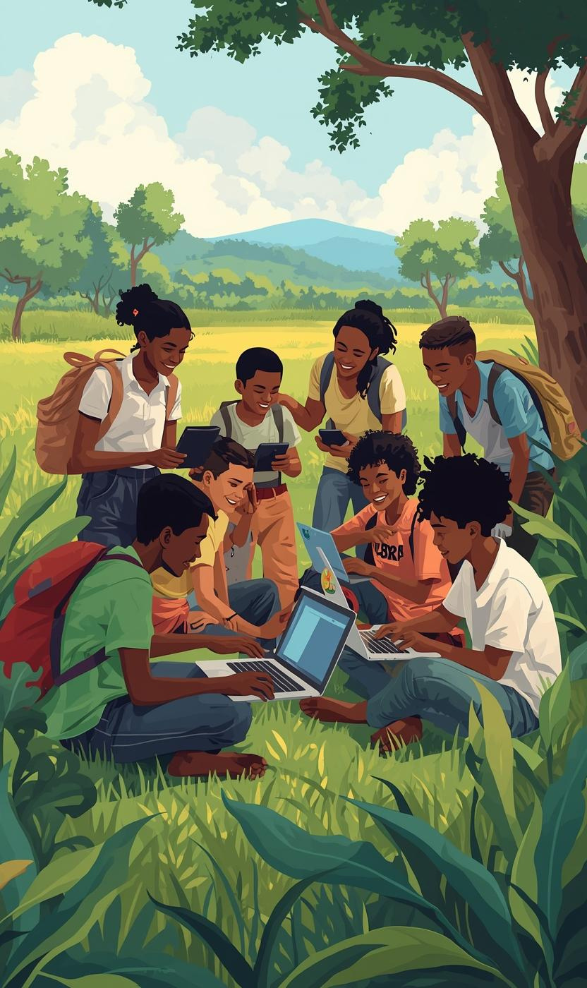
Addressing the Youth Employment Gap
BRIDGING SKILLS AND OPPORTUNITIES
Graduates often lack relevant skills, leading to high unemployment. Limited job networks disproportionately affect rural youth, exacerbating existing inequalities.

Slide 8
Tech Solutions for Talent Matching
AI-POWERED JOB MATCHING
AI technology analyzes resumes and job requirements, ensuring optimal matches for candidates, thus improving job placement success and efficiency.
SKILL-BASED PROFILING
Profiles categorize individuals based on skills, allowing for targeted job opportunities that align with their unique capabilities and experiences.
INCLUSIVE ACCESS
Platforms ensure all users, regardless of background, can access job opportunities, bridging gaps and promoting diversity in the workforce.

Slide 9

Empowering Women Through Technology
BRIDGING THE DIGITAL DIVIDE
Women face significant barriers in technology access. Inclusive designs can enhance their engagement, ensuring technology empowers rather than excludes them from opportunities.

Slide 10
Design Principles for Social Impact
SIMPLICITY
ACCESSIBILITY
CULTURAL AWARENESS
Technology should be easy to use, minimizing complexity to ensure adoption and engagement, especially among underserved communities.
Ensuring technology is available to all, regardless of socioeconomic status, helps bridge gaps and fosters inclusive participation in society.
Understanding local customs and practices is vital for technology to resonate and be embraced within diverse communities, enhancing its effectiveness.

Slide 11
The Role of Engineers
BUILD FOR REAL NEEDS
Engineers must understand community requirements to create practical solutions that genuinely improve lives and address specific societal challenges effectively.
DESIGN WITH COMMUNITIES
Collaborating closely with communities ensures that technological solutions are culturally relevant, widely accepted, and tailored to local contexts and needs.
THINK LONG-TERM IMPACT
Technologists should prioritize sustainable practices that contribute to lasting benefits, fostering resilience and adaptability in the communities they serve.

Slide 12
The Future of Technology
COMMUNITY-DRIVEN INNOVATION
Community-driven innovation fosters local solutions that are tailored to specific challenges, empowering individuals to take charge of their development.
AFFORDABLE AND INCLUSIVE SYSTEMS
Affordable technology systems ensure that underserved populations can access essential services, bridging gaps and enabling participation in the digital economy.
TECHNOLOGY IN SOCIAL CONTEXT
Technology must be rooted in cultural and social contexts to be effective, enhancing relevance and adoption within diverse communities.

Slide 13
Conclusion: From Challenges to Solutions
INNOVATIVE THINKING
TECHNOLOGY AS A BRIDGE
IMPACT-DRIVEN CHANGE
Addressing societal challenges starts with creative solutions that leverage technology to transform communities and improve lives effectively.
Technology connects people to opportunities, creating pathways that facilitate access and inclusion for underserved populations in various sectors.
By focusing on impact-driven technologies, we can create sustainable solutions that genuinely enhance quality of life and empower communities.

Slide 14


Thank You for Your Attention
EMAIL ADDRESS
hello@reallygreatsite
SOCIAL MEDIA
@reallygreatsite
PHONE
123-456-7890

